Slide 1
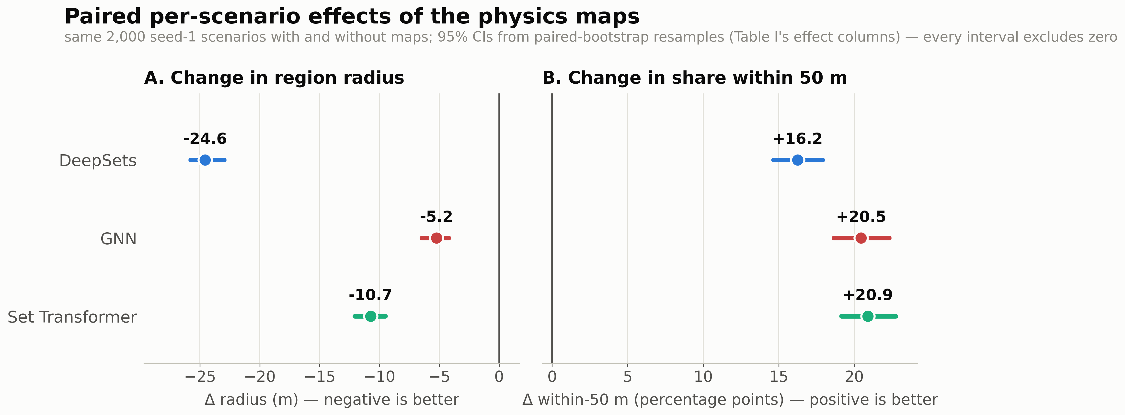
Adding the physics-derived maps shrinks the guaranteed search region for every architecture (−24.6 m DeepSets, −5.2 m GNN, −10.7 m Set Transformer) and raises the share of scenarios localized within 50 m by 16–21 percentage points. Every 95% confidence interval excludes zero.

